Slide 1
HPV Vaccination Recommendation Update: 2 doses or 3?
Debbie Saslow, PhD │ Senior Director, HPV-related and Women’s Cancers
American Cancer Society

Slide 2
Change to 2 Doses
Data from all 3 HPV vaccines
Immunogenicity only
Approved by FDA (October)
Recommended by ACIP (October)
Approved by CDC (October)
Publication in MMWR expected early to mid December

Slide 3
The Studies
Vaccine | Duration of Data | # of Studies | Status
2-valent | 5 years | 4 | Published
4-valent | 3 years | 2 | Published
9-valent | 1 year | 1 | Unpublished
*Antibody response is NOT as strong if the 2 doses are given
less than 5 months apart!

Slide 4
The Evidence: 9-valent
# Subjects | Participants | Schedule of Doses | Findings
300 | Male & Female | 0, 12 months | Antibody response 2-3 times higher for each HPV type
300 | Male | 0, 6 months
300 | Female | 0, 6 months
300 | Female | 0, 1-2, 6 months | Control
*Antibody response is NOT as strong if the 2 doses are given less than 5
months apart!

Slide 5
Recommendation
1st dose at 11-12 years old.
2nd dose 6-12 months after 1st dose.
If 1st dose given ≥15, need 3 doses.
If 2nd dose already given before 15th birthday and <5 months after 1st dose, need 3rd dose.
For people with weakened immune systems at any age, need 3 doses.

Slide 6
Message to Providers & Parents
Studies have shown that 2 doses of HPV vaccine work very well in younger adolescents and we expect the same long-lasting protection with 2 doses that we expect with 3 doses. (CDC)
The HPV vaccine works even better than we expected! (Dr. Noel Brewer)
Extra incentive to vaccinate on time.

Slide 7
Will ACS update our guideline?
When?

Slide 8
Vaccinating at AGE 11-12
SHOW ME THE EVIDENCE
Debbie Saslow, PhD
Notes:
One of the questions that we get most often, particularly from providers, is: why is the recommended age to vaccinate 11-12, and what is the evidence?

Slide 9
Many providers believe HPV vaccination can wait
Notes:
Many providers believe that it’s OK to delay giving HPV vaccination until their patient is a little older. Sometimes parents want to delay, but more often the provider assumes the parent wants to wait.

Slide 10
But what if we can prove that age 11-12 is best
and without talking about sex
Notes:
The most common reason for this is that the parent associates HPV vaccination with the onset of sexual activity. For the providers, they often want to avoid the discomfort of talking about sex. But what if we can prove that age 11-12 is best, backed by evidence?

Slide 11
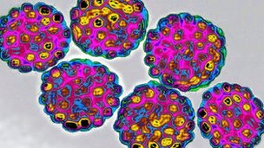
Why was age 11-12 recommended in the first place?
Notes:
Let’s go back in time 10 years and talk about why age 11-12 was recommended in the first place…

Slide 12
Clinical trial inclusion
Efficacy
Exposure
Duration of protection
Adolescent platform
Programmatic reasons
Immune Response???
Effectiveness
Notes:
Recommendations, whether they are for vaccines, drugs, or screening tests, are limited to who participated in the clinical trials that originally showed the vaccines, drugs, or screening tests were safe and worked. The HPV vaccine trials included girls ages 9-26, and later also included boys. So any recommendation would have to start no earlier than age 9 (which explains why this vaccine is not recommended for babies or toddlers), and extend no later than age 26.
Efficacy refers to whether and how well a vaccine works within a controlled study. For example, did HPV vaccines prevent HPV infections, genital warts, and cervical pre-cancers equally well across all age groups?
Another factor is age of exposure to HPV. This was based on national data of when kids start to have sex, because we have excellent data showing that HPV infections start to occur very soon after the onset of sexual activity. By 9th grade, about 25% of kids are already sexually active. So vaccination at age 14 would mean that 1 in every 4 kids would have potentially been exposed to HPV.
Duration of protection is difficult to predict for a new vaccine: we can only know how long protection against infection will last based on following the first people who have been vaccinated, i.e. clinical trial participants. Just as vaccinated too late would risk missing kids who would already be exposed, vaccinating too soon might mean that protection could wear off before the peak age of exposure and risk. Choosing age 11-12 was a safe balance between these 2 scenarios, and if protection did wane—say after 10 years—then a booster dose could be given. We are now confident that HPV vaccine protection does not wear off, based on over 10 years of data as well as modeling showing protection is expected to be lifelong.
10 years ago, when HPV vaccines were first licensed and approved for use, there were 2 other vaccines that had been introduced a year before – Tdap and Meningococcal – that were recommended at ages 11-12. There was interest in creating an “adolescent platform” that would be an added incentive for kids to continue to get their well checks at an age when these tend to drop off. Recommending all 3 vaccines at one time would also have some programmatic advantages.
We know that the antibody response following HPV vaccination is stronger at a younger age, particularly prior to age 15. We do not know whether this stronger immune response correlates to increased protection that is clinically relevant, which is why I included the ???
Finally, the most important basis for any recommendation is effectiveness: how well the vaccine works in the “real world” rather than a controlled research study.

Slide 13
Types of Evidence
Clinical Trial
Observational/Ecological
Linked
Notes:
So let’s fast forward to the present. New recommendations are based on clinical trials. Once a vaccine is approved and recommended and becomes widely used, the next type of studies are population-based. For example, after several years of HPV vaccination in this country, we saw the prevalence of HPV infections decline. But we didn’t know how much HPV infections declined in girls who were vaccinated at one age compared to another, or who got just the first dose compared to 2 doses compared to 3 doses. That level of evidence depends on studies using linked data: where you know this person got this many doses at this age and this is what happened to them this many years later.

Slide 14
Efficacy vs Effectiveness
Notes:
As I mentioned earlier, efficacy is how well a vaccine works in a study where you can control factors like getting each dose on time as well as who participates, e.g. whether someone has any history of abnormal Pap tests. Effectiveness is the “gold standard” because it tells you what happens in the real world where you can’t control for any of that. Efficacy data are very valuable to get things started, until effectiveness data become available.

Slide 15
Efficacy
the percent reduction in disease incidence in a vaccinated group compared with an unvaccinated control group under experimental conditions
 | Age at vaccination | Efficacy against CIN2 caused by HPV16/18
≤ 6 partners | 15-17 | 79.1%
 | 18-20 | 65.0%
 | 21-25 | 26.4% (not significant)
≤ 4 partners | <17 | 69.0%
 | 18-20 | 61.9%
 | 21-26 | 31.1%
Notes:
These are the efficacy data from the clinical trials. The top half of the table is from the Cervarix vaccine and the bottom of the table is from Gardasil. For both vaccines, you can see that efficacy against advance cervical precancers when you vaccinate at a younger age is double or triple the efficacy at older ages.

Slide 16
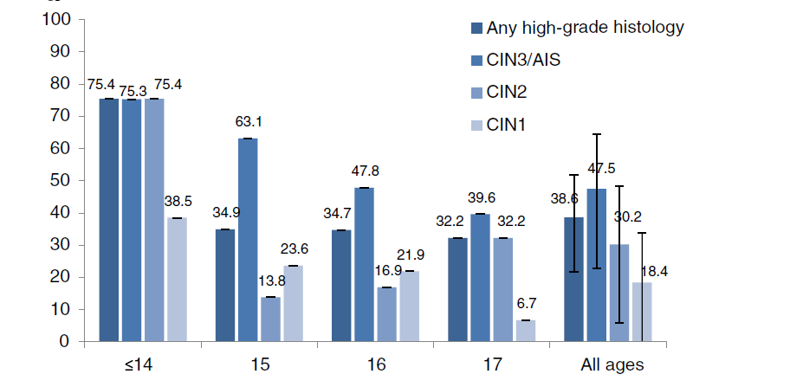
Population-based Effectiveness
% Reduction in cervical dysplasia 5 years after vaccination, by age in 2007
Gertig et al 2013: population-based data linkage, Victoria, Australia
Notes:
This is the next level of evidence that I mentioned: population based. This data from Australia shows that protection against advanced cervical pre-cancers drops with each year, and drops by about half when you compare vaccination by age 14 to vaccination by age 17.

Slide 17
Effectiveness
reduction in disease outcomes in a “real world” setting
Age at vaccination | Vaccine effectiveness against CIN2+
<17 | 75%
17-19 | 46%
≥20 | 22%
Herweijer et al 2016: register-based data, entire population of Sweden ages 13-29
Notes:
And now we come to the highest level of evidence: linked data. Again you can see that vaccination before age 17 is more than 3 times as effective than vaccination after age 19. So if you have a medical partner who asks why they can’t wait a year or two to vaccinate their patients, you ask that provider: would you rather reduce your patients’ risk of getting cancer by 75% or 25%? EVERY YEAR THAT YOU WAIT INCREASES THEIR RISK OF GETTING CANCER!

Slide 18
Effectiveness
reduction in disease outcomes in a “real world” setting
Age at vaccination | Odds of testing HPV16/18+ at first screen (age 20-21)
15-16 | 7.7%
17 | 12.5%
18 | 16.6%
19-21 | 30.3% (odds ratio 5.31)
Cameron et al 2016: linkage data, Scotland
Notes:
Here’s a similar study to the one I just showed which breaks down the age at vaccination even further. This shows that of the girls who were vaccinated at age 15-16 (this is as far back as we currently have, because girls who were vaccinated at age 11-12 are just now old enough to be screened, and it takes some time to collect, analyze, and publish the findings), and then get an HPV test at age 20 or 21, almost 8% of them are positive for 1 of the 2 types of HPV that cause the most cancers on the day of their test. Many more girls, probably another 8%, would have tested positive if you test them the week, month, or year before, but their HPV infection cleared. So this says by waiting until age 15-16, about 15% of girls are already at risk of getting cancer. IF you wait to vaccinate until age 17, you’ve almost doubled that risk. If you wait until age 19-21, the risk is now FIVE TIMES higher… with an astounding one third of girls testing positive just for one of the 2 types of HPV that causes most cancers, which you can double to two thirds of all girls having been infected by HPV 16 or 18. And again I ask you and any provider or parent who suggests waiting a year or 2 to vaccinate: why would you put your patient or child at risk? EVERY YEAR YOU WAIT, the risk of cancer increases, even doubles.

Slide 19
HEDIS
Efficacy vs Effectiveness
Notes:
There are some other reasons to vaccinate on time as well. The new HEDIS measure for boys and girls holds health plans accountable for completing vaccination with all 3 adolescent vaccines by the 13th birthday.

Slide 20
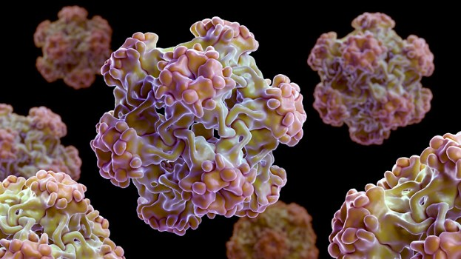
Preteens have 3 times as many preventive visits as adolescents
Only 38% of adolescents (ages 12-17) had a preventive visit in the last year
Notes:
We know that preteens are 3 times more likely to have a well visit than adolescents. You can’t vaccinate a child who doesn’t come into the provider’s office.

Slide 21
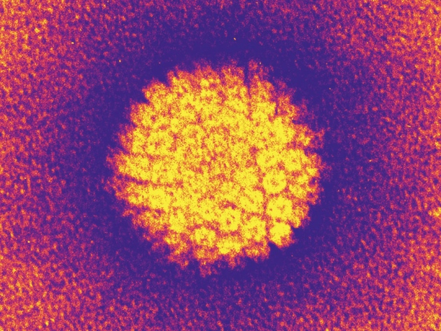
Temporary delays often become permanent
Notes:
We also know that when we think we are just waiting a year or 2, that often turns in to 3 or 4 years or vaccination just doesn’t happen at all.

Slide 22
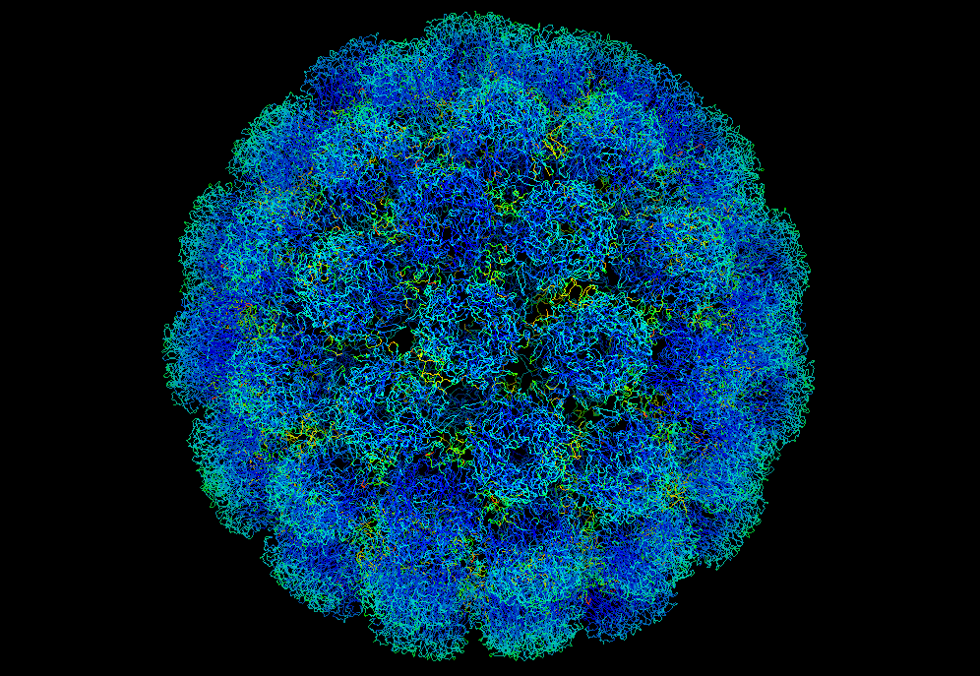
Because I said so
Efficacy vs Effectiveness
Notes:
And finally, I want to point out that this is the only vaccine where we’ve been asked to justify the recommended age. When was the last time a parent or provider asked why polio vaccine is recommended at 2 months and not 6 months, or why rubella is recommended at age 1 instead of 2, or why can’t I wait a year or 2 to vaccinate against chicken pox? I hope some day soon, providers and parents will be satisfied that the reason to vaccinate at age 11-12, or even at 9 or 10, is simply because that’s when the experts recommend it.

Slide 23
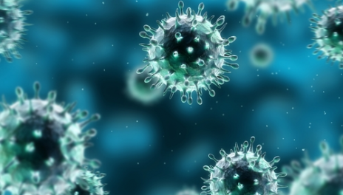
Thank You

