Slide 1
10 Things You Should Know About HPV

Slide 2
10 THINGS TO KNOW ABOUT HPV:
10. HPV infection is common
9. HPV infection can cause cancer
8. Preventing cancer is better than treating it
7. HPV vaccine is cancer prevention
6. HPV vaccine works and lasts
5. HPV vaccine is safe
4. HPV vaccine is given with the other preteen vaccines
3. HPV vaccination is best at ages 11 or 12 years
2. HPV vaccination is even easier than before
1. Most parents choose HPV vaccination for their children

Slide 3
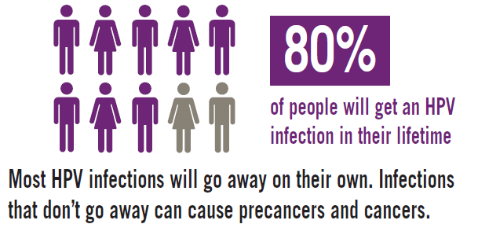
10. HPV INFECTION IS COMMON
Notes:
HPV stands for human papillomavirus. There are more than 40 HPV types that can infect the genital areas of males and females. These HPV types can also infect the mouth and throat. Most people with HPV do not develop symptoms or health problems from it. In 90% of cases, the body’s immune system clears HPV within two years. But there is no way to know which people who get HPV will go on to develop health problems.
Most people never know that they have been infected unless a woman has an abnormal pap test with a positive HPV test or if a man or a woman is diagonosed with genital warts and are told they are caused by an HPV infection.
Most HPV infections happen during the teen and college-aged years.

Slide 4
Every year in the United States 31,500 people are diagnosed with a cancer caused by HPV
9. HPV INFECTION CAN CAUSE CANCER
Cancer site | Number probably caused by any HPV type |  |  | Percentage probably caused by any HPV type
 | Male | Female | Both Sexes
Anus | 1,600 | 3,200 | 4,800 | 91%
Cervix | 0 | 10,600 | 10,600 | 91%
Oropharynx | 9,600 | 2,000 | 11,600 | 70%
Penis | 700 | 0 | 700 | 63%
Rectum | 200 | 500 | 700 | 91%
Vagina | 0 | 600 | 600 | 75%
Vulva | 0 | 2,500 | 2,500 | 69%
TOTAL | 12,100 | 19,400 | 31,500
Notes:
Persistent HPV infection can cause cancer in both men and women. HPV infection can cause cervical, vaginal, and vulvar cancers in women and penile cancer in men. HPV can also cause anal cancer, mouth/throat (oropharyngeal) cancer, and genital warts in both men and women.

Slide 5
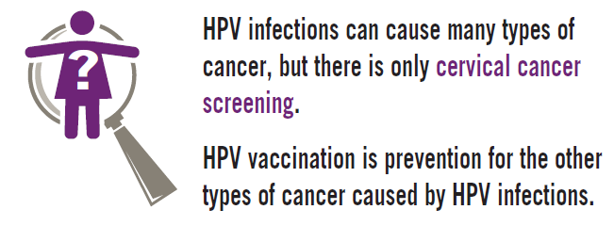
8. PREVENTING CANCER
IS BETTER THAN TREATING IT
Notes:
Without protection from HPV infections, 2 million women each year are affected by the diseases caused by persistant HPV infection. That means they all have to return to the doctor to have additional testing performed on their cervix. Low grade, or less severe, precancers of the cervix require biopsies. High grade, or severe, precancers of the cervix require biopsies and treatment. Cervical cancer is often treated with radiation, chemotherapy, and/or hysterectomy, all of which can leave younger women unable to have children. One in three cervical cancers are diagnosed in women who are between the ages of 20 and 44 years, when they would be having children.

Slide 6
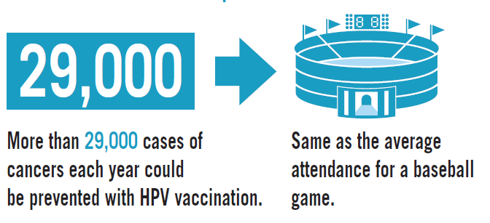
7. HPV VACCINE IS CANCER PREVENTION
Notes:
Without protection from HPV infections, 2 million women each year are affected by the diseases caused by persistant HPV infection. That means they all have to return to the doctor to have additional testing performed on their cervix. Low grade, or less severe, precancers of the cervix require biopsies. High grade, or severe, precancers of the cervix require biopsies and treatment. Cervical cancer is often treated with radiation, chemotherapy, and/or hysterectomy, all of which can leave younger women unable to have children. One in three cervical cancers are diagnosed in women who are between the ages of 20 and 44 years, when they would be having children.

Slide 7
6. HPV VACCINE IS SAFE
  Extensive safety testing
  No serious sides effects cause by HPV vaccine
  HPV vaccine safety similar to meningococcal and Tdap vaccine safety
Most HPV vaccine side effects are mild
  Most common side effects are pain and redness
  Sitting during and for 15 minutes after any shot reduces fainting that can cause injury
Notes:
Like all medical products, vaccines can cause side effects. The most common side effects of HPV vaccines are mild and go away on their own, like pain and redness in the arm where the shot was given. Occasionally, patients might faint after receiving an injectable vaccine. Preteens and teens should sit or lie down when they get a shot and stay like that for about 15 minutes after the shot. This can help prevent fainting and any injury that could happen while fainting.
The cancer prevention benefits of HPV vaccination far outweigh the risk of these side effects.
All vaccines used in the United States are required to go through extensive safety testing before they are licensed by FDA. Once in use, they are continually monitored for safety and effectiveness. Numerous research studies have been conducted to make sure HPV vaccines were safe both before and after the vaccines were licensed. No serious safety concerns have been confirmed in the large safety studies that have been done since HPV vaccine became available in 2006. CDC and FDA have reviewed the safety information available to them for both HPV vaccines and have determined that they are both safe. The HPV vaccine is made from one protein from the HPV virus that is not infectious (cannot cause HPV infection) and non-oncogenic (does not cause cancer).

Slide 8
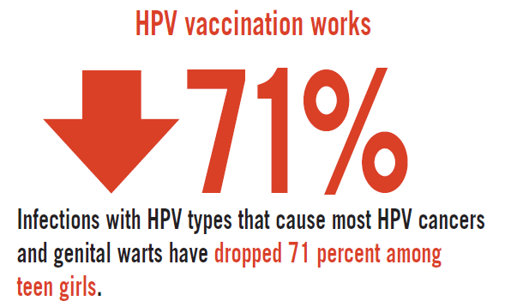
5. HPV VACCINE WORKS AND IT LASTS
Notes:
The HPV vaccine works extremely well. In the four years after the vaccine was recommended in 2006, the amount of HPV infections in teen girls decreased by 56%. Research has also shown that fewer teens are getting genital warts since HPV vaccines have been in use. In other countries such as Australia, research shows that HPV vaccine has already decreased the amount of pre-cancer of the cervix in women, and genital warts have decreased dramatically in both young women and men.
Data from clinical trials and ongoing research tell us that the protection provided by HPV vaccine is long-lasting. Currently, it is known that HPV vaccine works in the body for at least 10 years without becoming less effective. Data suggest that the protection provided by the vaccine will continue well beyond 10 years.

Slide 9
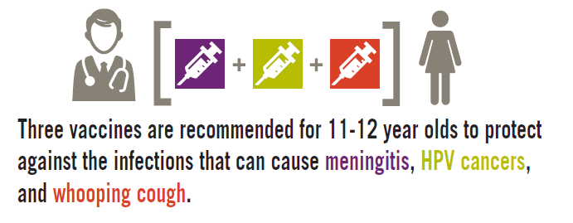
4. HPV VACCINE SHOULD BE GIVEN WITH THE OTHER PRETEEN VACCINES

Slide 10


3. HPV VACCINATION IS BEST
AT AGES 11 OR 12 YEARS
Girls & Boys can start HPV vaccination at age 9
Preteens should finish HPV vaccine series by 13th birthday
Plus girls 13-26 years old who haven’t started or finished HPV vaccine series
Plus boys 13-21 years old who haven’t started or finished HPV vaccine series

Slide 11
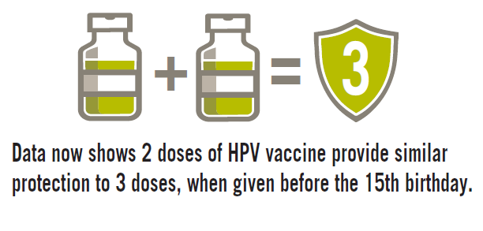
2. HPV VACCINATION
IS EVEN EASIER THAN BEFORE

Slide 12
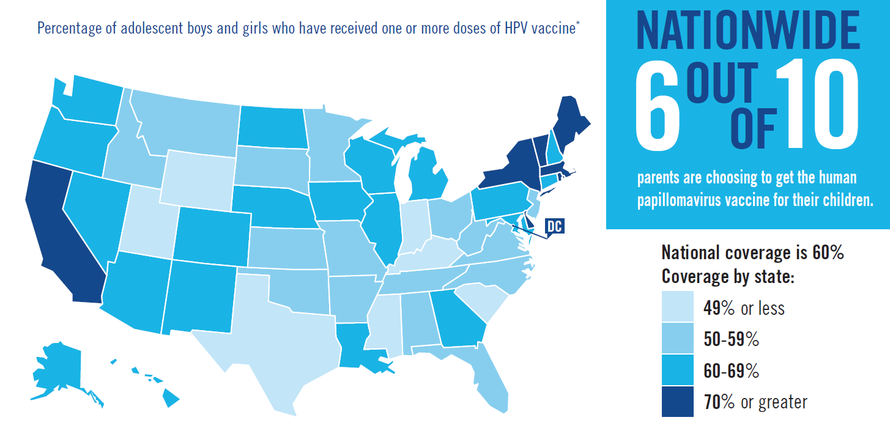
1. MOST PARENTS CHOOSE HPV VACCINATION FOR THEIR CHILDREN

Slide 13
Add contact info

